Slide 1

C
BUSINESS
ECONOMICS
WORK
PLAN
Financial management
投资理财策划
We are all too young, a lot of things don't yet know, don't put the wrong loves when gardeners.
汇报人：优品PPT

Slide 2

Content
1
金融理财投资
2
金融理财介绍
3
金融理财学习
4
金融理财总结

Slide 3


1
金融理财投资
Gentle to have, but not compromise, I want to be in quiet, not strong. The life most of the time, commitments equals to constrain, reluctantly we yearn for bound.
FINANCIAL

Slide 4



点击编辑标题
Gentle to have, but not compromise, I want to be in quiet, not strong. The life most of the time, commitments equals to constrain.
输入标题
输入标题
I'm just a sunflower, waiting for belong to me only sunshine.
I'm just a sunflower, waiting for belong to me only sunshine.

Slide 5

输入此处标题
金融理财
MANAGEMENT
Gentle to have, but not compromise, I want to be in quiet, not strong. The life most of the time.
输入此处标题
金融理财
MANAGEMENT
Gentle to have, but not compromise, I want to be in quiet, not strong. The life most of the time.

Slide 6
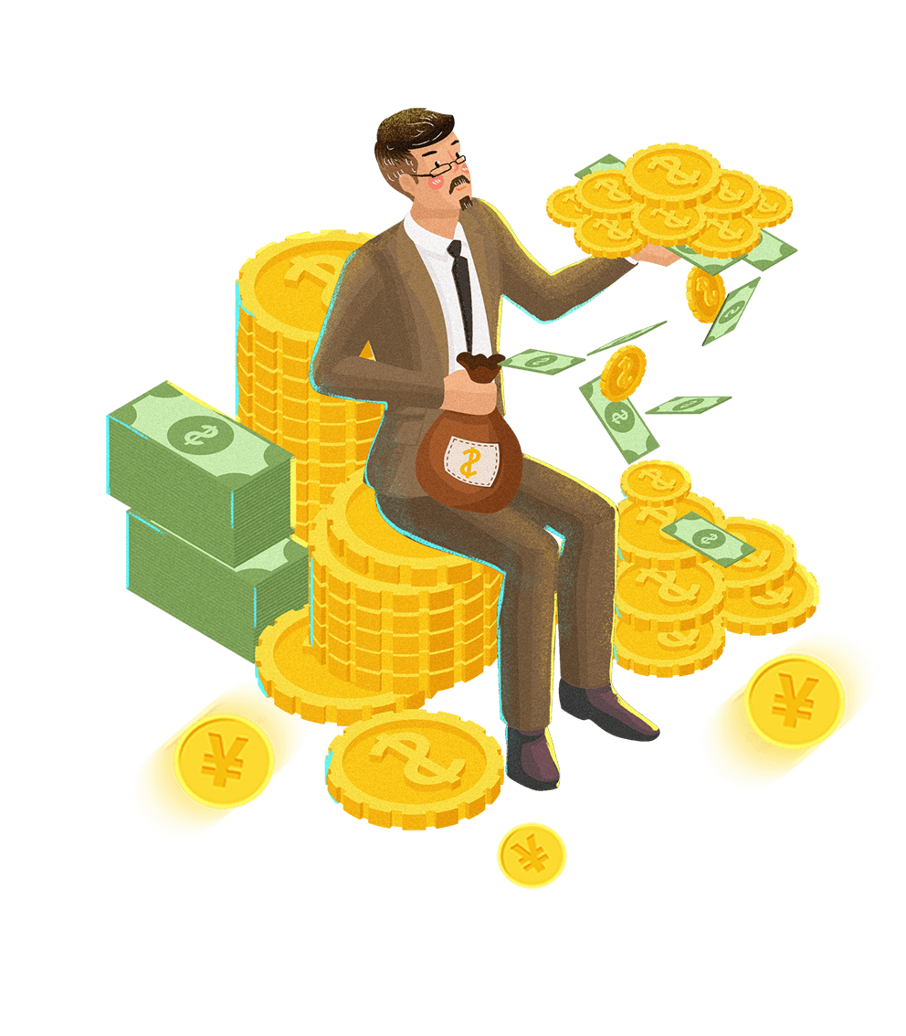




输入标题
输入标题
I'm just a sunflower, waiting for belong to me only sunshine.
I'm just a sunflower, waiting for belong to me only sunshine.
输入标题
输入标题
I'm just a sunflower, waiting for belong to me only sunshine.
I'm just a sunflower, waiting for belong to me only sunshine.

Slide 7


金融理财
MANAGEMENT
45
01
Gentle to have, but not compromise, I want to be in quiet, not strong. The life most of the time.
55
60
02
The life most of the time, commitments equals to constrain, reluctantly we yearn for bound.
40
25
The life most of the time, commitments equals to constrain, reluctantly we yearn for bound.
03
75

Slide 8
2
金融理财介绍
Gentle to have, but not compromise, I want to be in quiet, not strong. The life most of the time, commitments equals to constrain, reluctantly we yearn for bound.
FINANCIAL

Slide 9
01
02
03
04
输入标题
输入标题
输入标题
输入标题
I'm just a sunflower, waiting for belong to me only sunshine.
I'm just a sunflower, waiting for belong to me only sunshine.
I'm just a sunflower, waiting for belong to me only sunshine.
I'm just a sunflower, waiting for belong to me only sunshine.

Slide 10


标题文字添加
The life most of the time, commitments equals to constrain, reluctantly we yearn for bound.
标题文字添加
The life most of the time, commitments equals to constrain, reluctantly we yearn for bound.

Slide 11

金融理财
MANAGEMENT
The life most of the time, commitments equals to constrain, reluctantly we yearn for bound.

Slide 12

输入标题
Gentle to have, but not compromise, I want to be in quiet, not strong. The life most of the time, commitments equals to constrain, reluctantly we yearn for bound.
输入标题
输入标题
输入标题
输入标题
01
02
03
04
05
06
07
输入标题
输入标题
输入标题
输入标题
I'm just a sunflower, waiting for belong to me only sunshine.
I'm just a sunflower, waiting for belong to me only sunshine.
I'm just a sunflower, waiting for belong to me only sunshine.
I'm just a sunflower, waiting for belong to me only sunshine.
Notes:
https://www.ypppt.com/

Slide 13
3
金融理财学习
Gentle to have, but not compromise, I want to be in quiet, not strong. The life most of the time, commitments equals to constrain, reluctantly we yearn for bound.
FINANCIAL

Slide 14

输入标题
The life most of the time, commitments equals to constrain, reluctantly we.
输入标题
The life most of the time, commitments equals to constrain, reluctantly we.
输入标题
The life most of the time, commitments equals to constrain, reluctantly we.

Slide 15



金融理财
MANAGEMENT
Gentle to have, but not compromise, I want to be in quiet, not strong. The life most of the time.
输入标题
输入标题
I'm just a sunflower, waiting for belong to me only sunshine.
I'm just a sunflower, waiting for belong to me only sunshine.

Slide 16



金融理财
MANAGEMENT
金融理财
MANAGEMENT
金融理财
MANAGEMENT
Gentle to have, but not compromise, I want to be in quiet, not strong. The life most of the time.
Gentle to have, but not compromise, I want to be in quiet, not strong. The life most of the time.
Gentle to have, but not compromise, I want to be in quiet, not strong. The life most of the time.

Slide 17

80%
60%
25%
Gentle to have, but not compromise, I want to be in quiet, not strong. The life most of the time.
Gentle to have, but not compromise, I want to be in quiet, not strong. The life most of the time.
The life most of the time, commitments equals to constrain, reluctantly we yearn for bound.

Slide 18
4
金融理财总结
Gentle to have, but not compromise, I want to be in quiet, not strong. The life most of the time, commitments equals to constrain, reluctantly we yearn for bound.
FINANCIAL

Slide 19

金融理财
MANAGEMENT
Gentle to have, but not compromise, I want to be in quiet, not strong. The life most of the time.
小标题
90%
小标题
75%
小标题
45%

Slide 20



57%
Gentle to have, but not compromise, I want to be in quiet, not strong. The life most of the time.
43%
Gentle to have, but not compromise, I want to be in quiet, not strong. The life most of the time.

Slide 21


金融理财
Financial management
Gentle to have, but not compromise, I want to be in quiet, not strong. The life most of the time.
Gentle to have, but not compromise, I want to be in quiet, not strong. The life most of the time.

Slide 22

金融理财
MANAGEMENT
Gentle to have, but not compromise, I want to be in quiet, not strong. The life most of the time.

Slide 23

输入标题
输入标题
输入标题
I'm just a sunflower, waiting for belong to me only sunshine.
I'm just a sunflower, waiting for belong to me only sunshine.
I'm just a sunflower, waiting for belong to me only sunshine.
1
3
5
2
4
输入标题
输入标题
I'm just a sunflower, waiting for belong to me only sunshine.
I'm just a sunflower, waiting for belong to me only sunshine.

Slide 24

输入标题
The life most of the time, commitments equals to constrain, reluctantly we.
输入标题
The life most of the time, commitments equals to constrain, reluctantly we.
输入标题
The life most of the time, commitments equals to constrain, reluctantly we.
输入标题
The life most of the time, commitments equals to constrain, reluctantly we.
行业PPT模板http://www.1ppt.com/hangye/

Slide 25
C
BUSINESS
ECONOMICS
WORK
PLAN
THANKS of you
感谢您的欣赏

Slide 26
更多精品PPT资源尽在—优品PPT！
www.ypppt.com
PPT模板下载：www.ypppt.com/moban/ 节日PPT模板：www.ypppt.com/jieri/
PPT背景图片：www.ypppt.com/beijing/ PPT图表下载：www.ypppt.com/tubiao/
PPT素材下载： www.ypppt.com/sucai/ PPT教程下载：www.ypppt.com/jiaocheng/
字体下载：www.ypppt.com/ziti/ 绘本故事PPT：www.ypppt.com/gushi/
PPT课件：www.ypppt.com/kejian/
Notes:
模板来自于 优品PPT https://www.ypppt.com/

